Slide 1
MS is #3 in the country for elementary school suspensions
Over 10,000 elementary schoolers suspended in 2011-2012
61 preschoolers suspended in 2017

Slide 2
75% of elementary school students suspended in MS are Black
Over half of preschoolers suspended in MS are Black
Disproportionate involvement of SWD

Slide 3
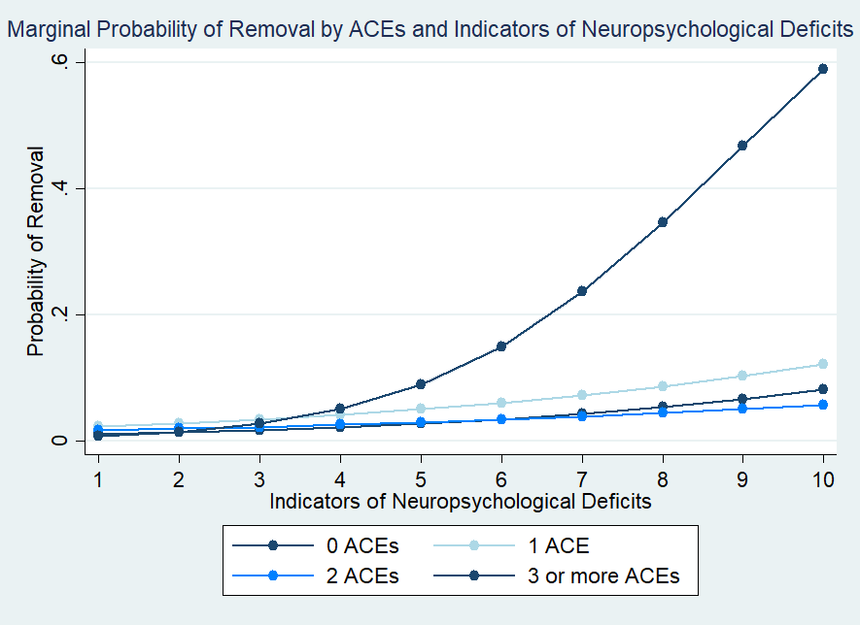

Slide 4
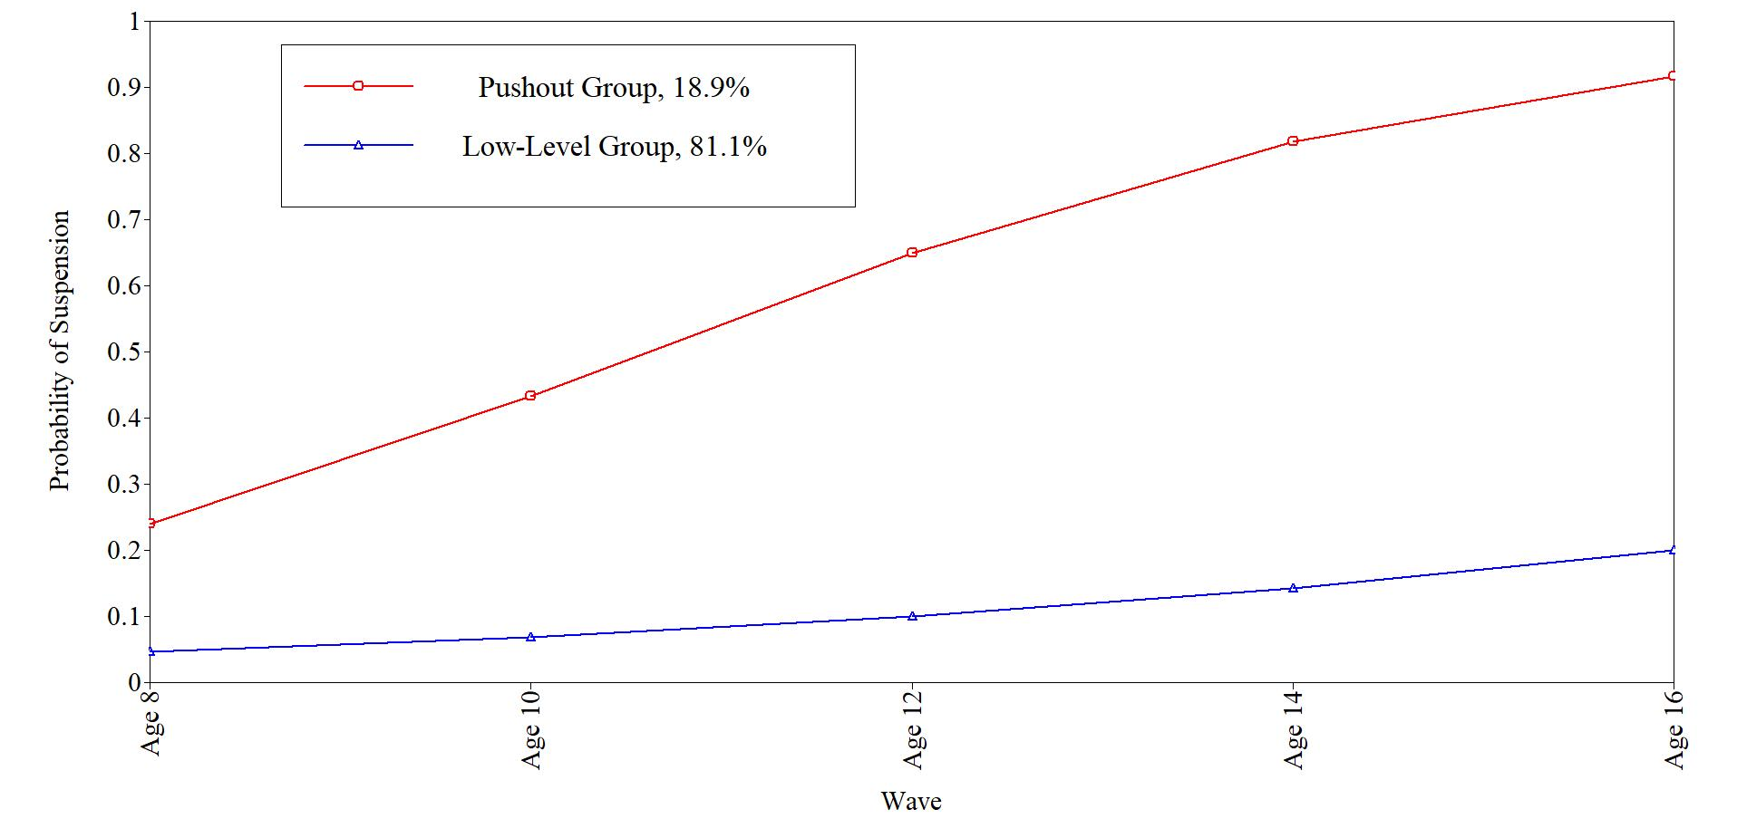

Slide 5
What Do we know?
Males, Black children and kids with trauma and early indicators of need more likely to be suspended
Kids who are suspended early are likely to be suspended again and again
Also likely to be arrested, experience JSC

Slide 6
What can we do?
Best practice suggests mental health services, policy changes, teacher diversity
What can we do in Mississippi?

